Slide 1
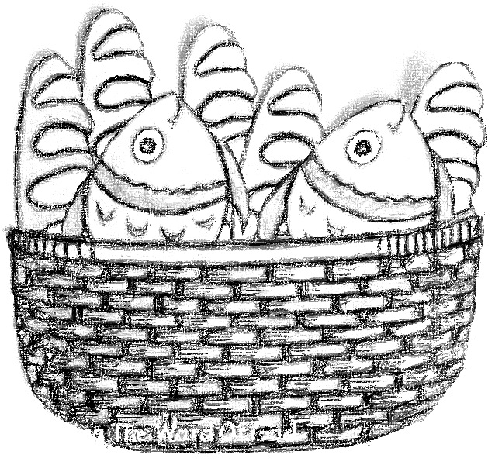
MUNCH,
MUNCH,
MUNCH
Chris Jaensch

Slide 2
Jesus was a busy man,
God’s own son.
He showed His love
and shared the good news
with everyone.
Jesus was a busy man every day,
talking to the people,
healing the sick
and showing them the way.

Slide 3
Showing them the way,
showing them the way,
showing them the way
every day.

Slide 4
Not 1, not 2, not 3, not 4,
But…
Five thousand people
sitting on a hill.
with hungry tummies
they could not sit still.
With some bread and fish
from a young boy’s lunch
Jesus fed the lot of them.
Munch, munch munch.

Slide 5
Munch, munch munch,
munch, munch munch,
munch, munch munch.
What a lovely lunch.

Slide 6
One very special day
on a mountainside
Jesus was followed by a mighty crowd.
Their tummies were hungry.
They needed lunch
but so much food
would just cost too much.
Cost too much, cost too much,
cost too much, far too much.

Slide 7
Not 1, not 2, not 3, not 4,
But…
Five thousand people
sitting on a hill.
with hungry tummies
they could not sit still.
With some bread and fish
from a young boy’s lunch
Jesus fed the lot of them.
Munch, munch munch.

Slide 8
Munch, munch munch,
munch, munch munch,
munch, munch munch.
What a lovely lunch.

Slide 9
There was a boy there.
He’d come prepared.
He had some food,
some fish and some bread.
Jesus said a prayer.
He told his disciples the food to share.
They all had their fill
and there was tons to spare.
Tons to spare, tons to spare,
tons to spare, plenty to spare.

Slide 10
Not 1, not 2, not 3, not 4,
But…
Five thousand people
sitting on a hill.
with hungry tummies
they could not sit still.
With some bread and fish
from a young boy’s lunch
Jesus fed the lot of them.
Munch, munch munch.

Slide 11
Munch, munch munch,
munch, munch munch,
munch, munch munch.
What a lovely lunch.
Munch, munch munch,
munch, munch munch,
munch, munch munch,
munch, munch munch.
What a lovely lunch!

